Slide 1


Unlock the Power of MS Excel: Master your Data
By: Zeshan Ali
CTO D-Explore-X

Slide 2
D Explore X
ERP & Web Developmenet
Trainings
Providing Trainings in all trending skills
Artificial intelligence
Developing and teaching AI trainings in Machine learning and Data Science
Medium to smart scale solutions
Contact at : 0304-1148884

Slide 3
MS Excel
MS Excel is a commonly used Microsoft Office application. It is a spreadsheet program which is used to save and analyse numerical data.

Slide 4
Work Book
A worksheet is the electronic equivalent of a paper ledger. It is a powerful platform used to enter, analyze, calculate, and manipulate data. A worksheet can be used for basic calculations such as addition and subtraction, as well as more complicated applications like statistics, audits, or mortgage tables. Moreover, worksheets allow you to quickly format your data into effective business reports.

Slide 5
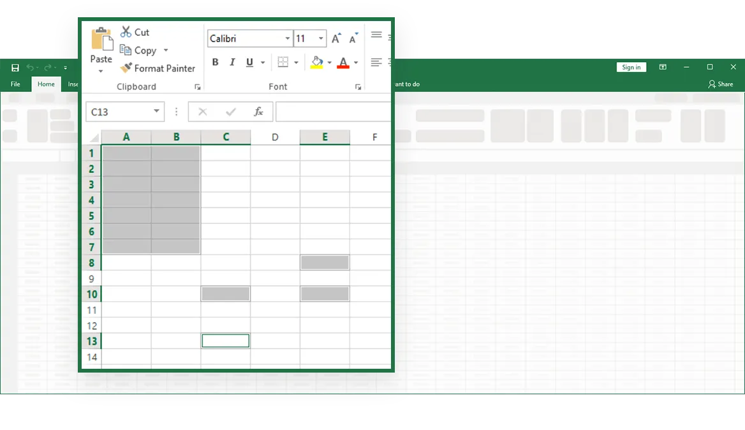
Worksheet
A worksheet is a grid of 1, 048, 576 rows and 16, 384 columns. The rows are labeled with numbers (1, 2, 3, ...) and the columns are labeled with letters (A, B, C, ..., AA, AB, AC,...), as illustrated in Figure1-1. The intersection of a row and column is a cell, the basic unit for storing data.

Slide 6
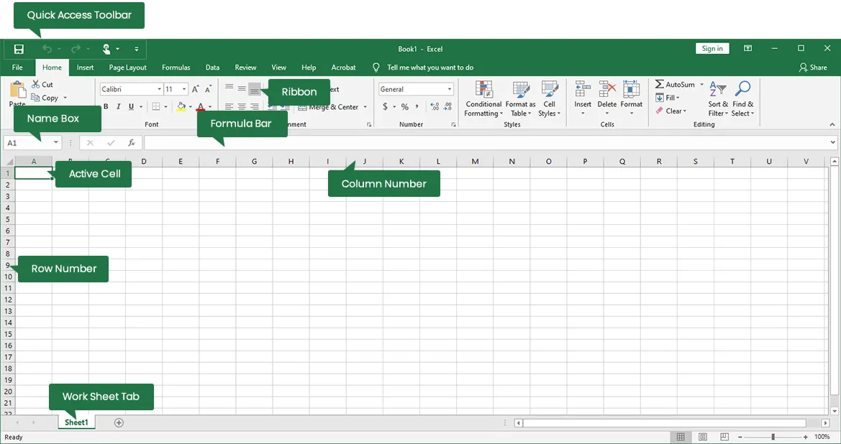
Main Window

Slide 7
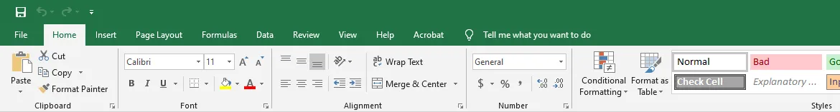
The Ribbon
The Ribbon is the strip of buttons and icons, organized into TABS, located above the work area in Excel 2013. The Ribbon (with its various tabs) replaces the menus and toolbars found in earlier versions of Excel. At the top of the actual Ribbon are a number of tabs, such as Home, Insert, and Page Layout. Clicking on a tab displays the options located in this section of the ribbon.

Slide 8
Ribbon
Home
Comprises options like font size, font styles, font colour, background colour, alignment, formatting options and styles, insertion and deletion of cells and editing options
Insert
Comprises options like table format and style, inserting images and figures, adding graphs, charts and sparklines, header and footer option, equation and symbols
Page Layout
Themes, orientation and page setup options are available under the page layout option
Formulas
Since tables with a large amount of data can be created in MS excel, under this feature, you can add formulas to your table and get quicker solutions
Data
Adding external data (from the web), filtering options and data tools are available under this category
Review
Proofreading can be done for an excel sheet (like spell check) in the review category and a reader can add comments in this part
View
Different views in which we want the spreadsheet to be displayed can be edited here. Options to zoom in and out and pane arrangement are available under this category

Slide 9
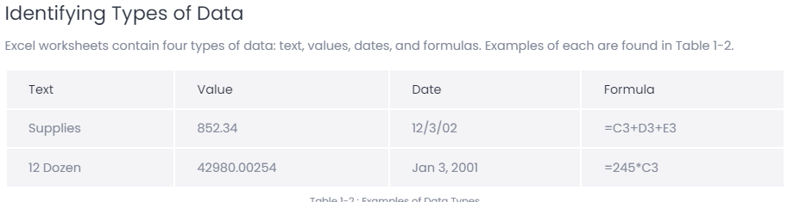
Data and its types
Data is collection of Raw facts and Figures.
We work and generate tons of data daily , that is used in daily life decision making and other economical
Activities , here are some types of data that we used in our daily life.

Slide 10
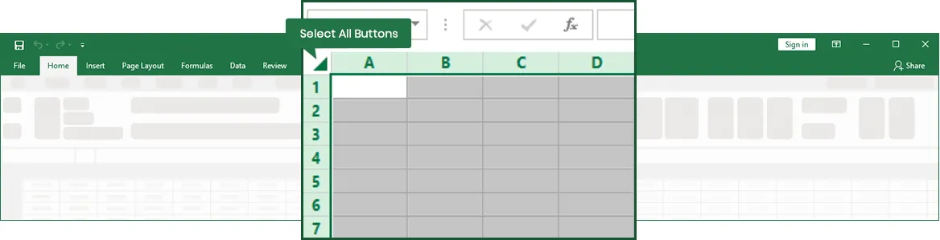
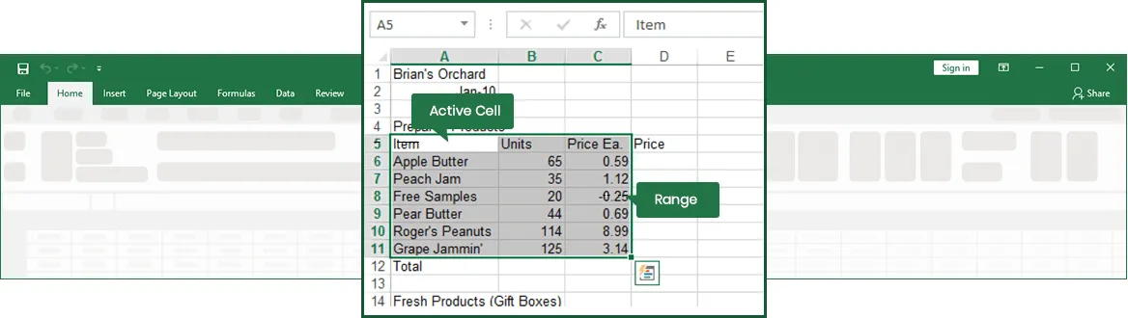
Working with Selection
Range Selection

Slide 11
Function and formula in Excel
The backbone of Excel is its ability to perform calculations. There are two ways to set up calculations in Excel:
using formulas or using functions. Formulas are mathematical expressions that you build yourself. You need to follow proper math principles in order to obtain the expected answer. Building the formula is simply a matter of combining the proper cell addresses with the correct operators in the right order. This module will explore how to build, edit, and copy formulas. This module will also explain the difference between relative and absolute references. Finally, this module will explain how to use the Status Bar to perform simple calculations.

Slide 12
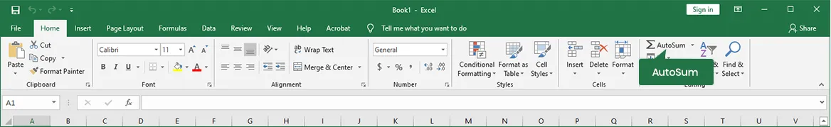
Using the Sum Function
Select the AutoSum tool in the Editing Group on the Home tab of the Ribbon.

Slide 13
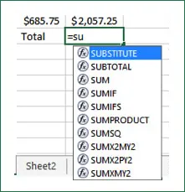
Using Auto Complete
Begin typing the SUM function. As soon as you type the Equals sign and the letter S, Excel displays a possible list of matching functions.

Slide 14
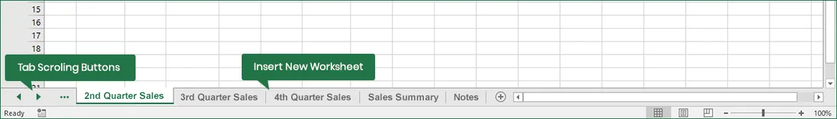
Working With Multiple Sheet
Sometimes, you'll want to change the order of the worksheets in a workbook. For instance, assume you created a sequence of worksheets named 1993, 1992, 2000, 2001, and 1999. At the time, it might have been convenient, but now it doesn’t make much sense. Luckily, Excel provides tools to make reorganizing the workbook easy. You can reorder worksheets by moving them. Making copies of worksheets is also useful for a number of reasons. For example, you might want to experiment with a table without affecting the original data. Using a duplicate worksheet makes this easy and safe.

Slide 15
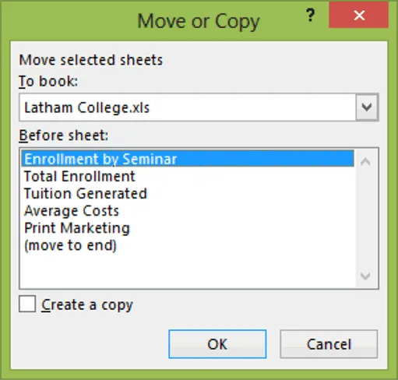
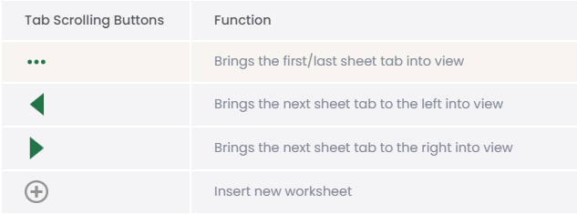
Creating new sheet

Slide 16
Conditional Formatting
Conditional formatting in Excel is a feature that automatically applies formatting to cells based on their values. This can be used to highlight patterns, trends, or outliers in data. For example, you can use conditional formatting to: Highlight sales figures above a certain number, Flag overdue tasks, and Color-code data trends.

Slide 17
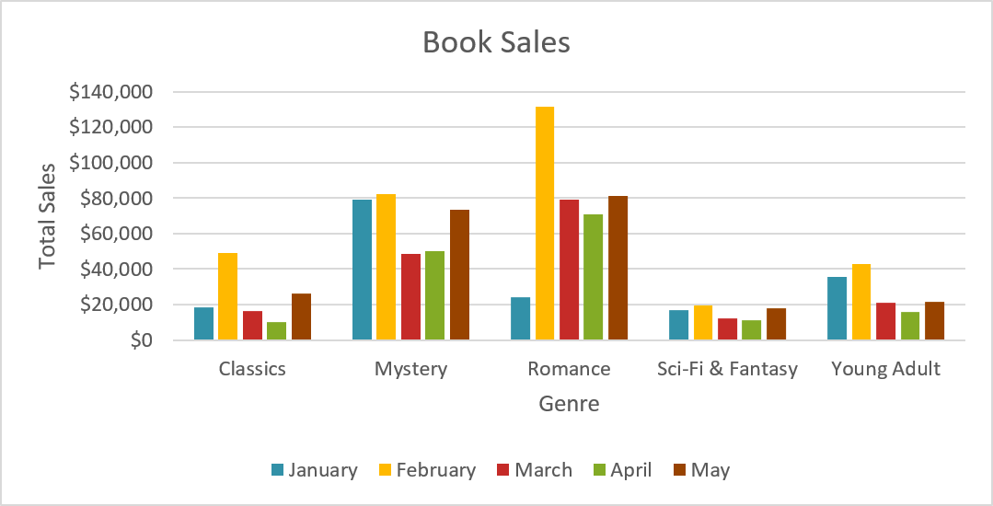
Graphs and charts in Excel
Charts are used to display series of numeric data in a graphical format to make it easier to understand large quantities of data and the relationship between different series of data. Excel supports many types of charts to help you display data in ways that are meaningful to your audience.

Slide 18
Thanks You ! Any Questions?

